Slide 1



Airbnb Global Price Analysis
December 5, 2023
Group 53
Richard Wang 509402
Jimeng Yin 516867
Bosan Hsu 519095

Slide 2

Part 1: Introduction

Slide 3
Our Data
Data: Airbnb's global price
Time Collected: Last updated four months ago.
Data Size: 1.94 GB
Data Source: Kaggle by Joakim Arvidsson
Source Link: https://www.kaggle.com/datasets/joebeachcapital/airbnb
Number of Columns: 89
Number of Records: 36,248,263
Data Type: Structured
Notes:
Our data talks about Airbnb's global price. The data on house prices is dynamic, so our data set was last uploaded four months ago. This dataset size is about 1.94 GB. This dataset is collected from Kaggle by JoaKim Arvidsson. There's the source link if u guys interest in. This dataset has 89 colunms and thirty-six million records. And we make sure this is the structured data type.

Slide 4
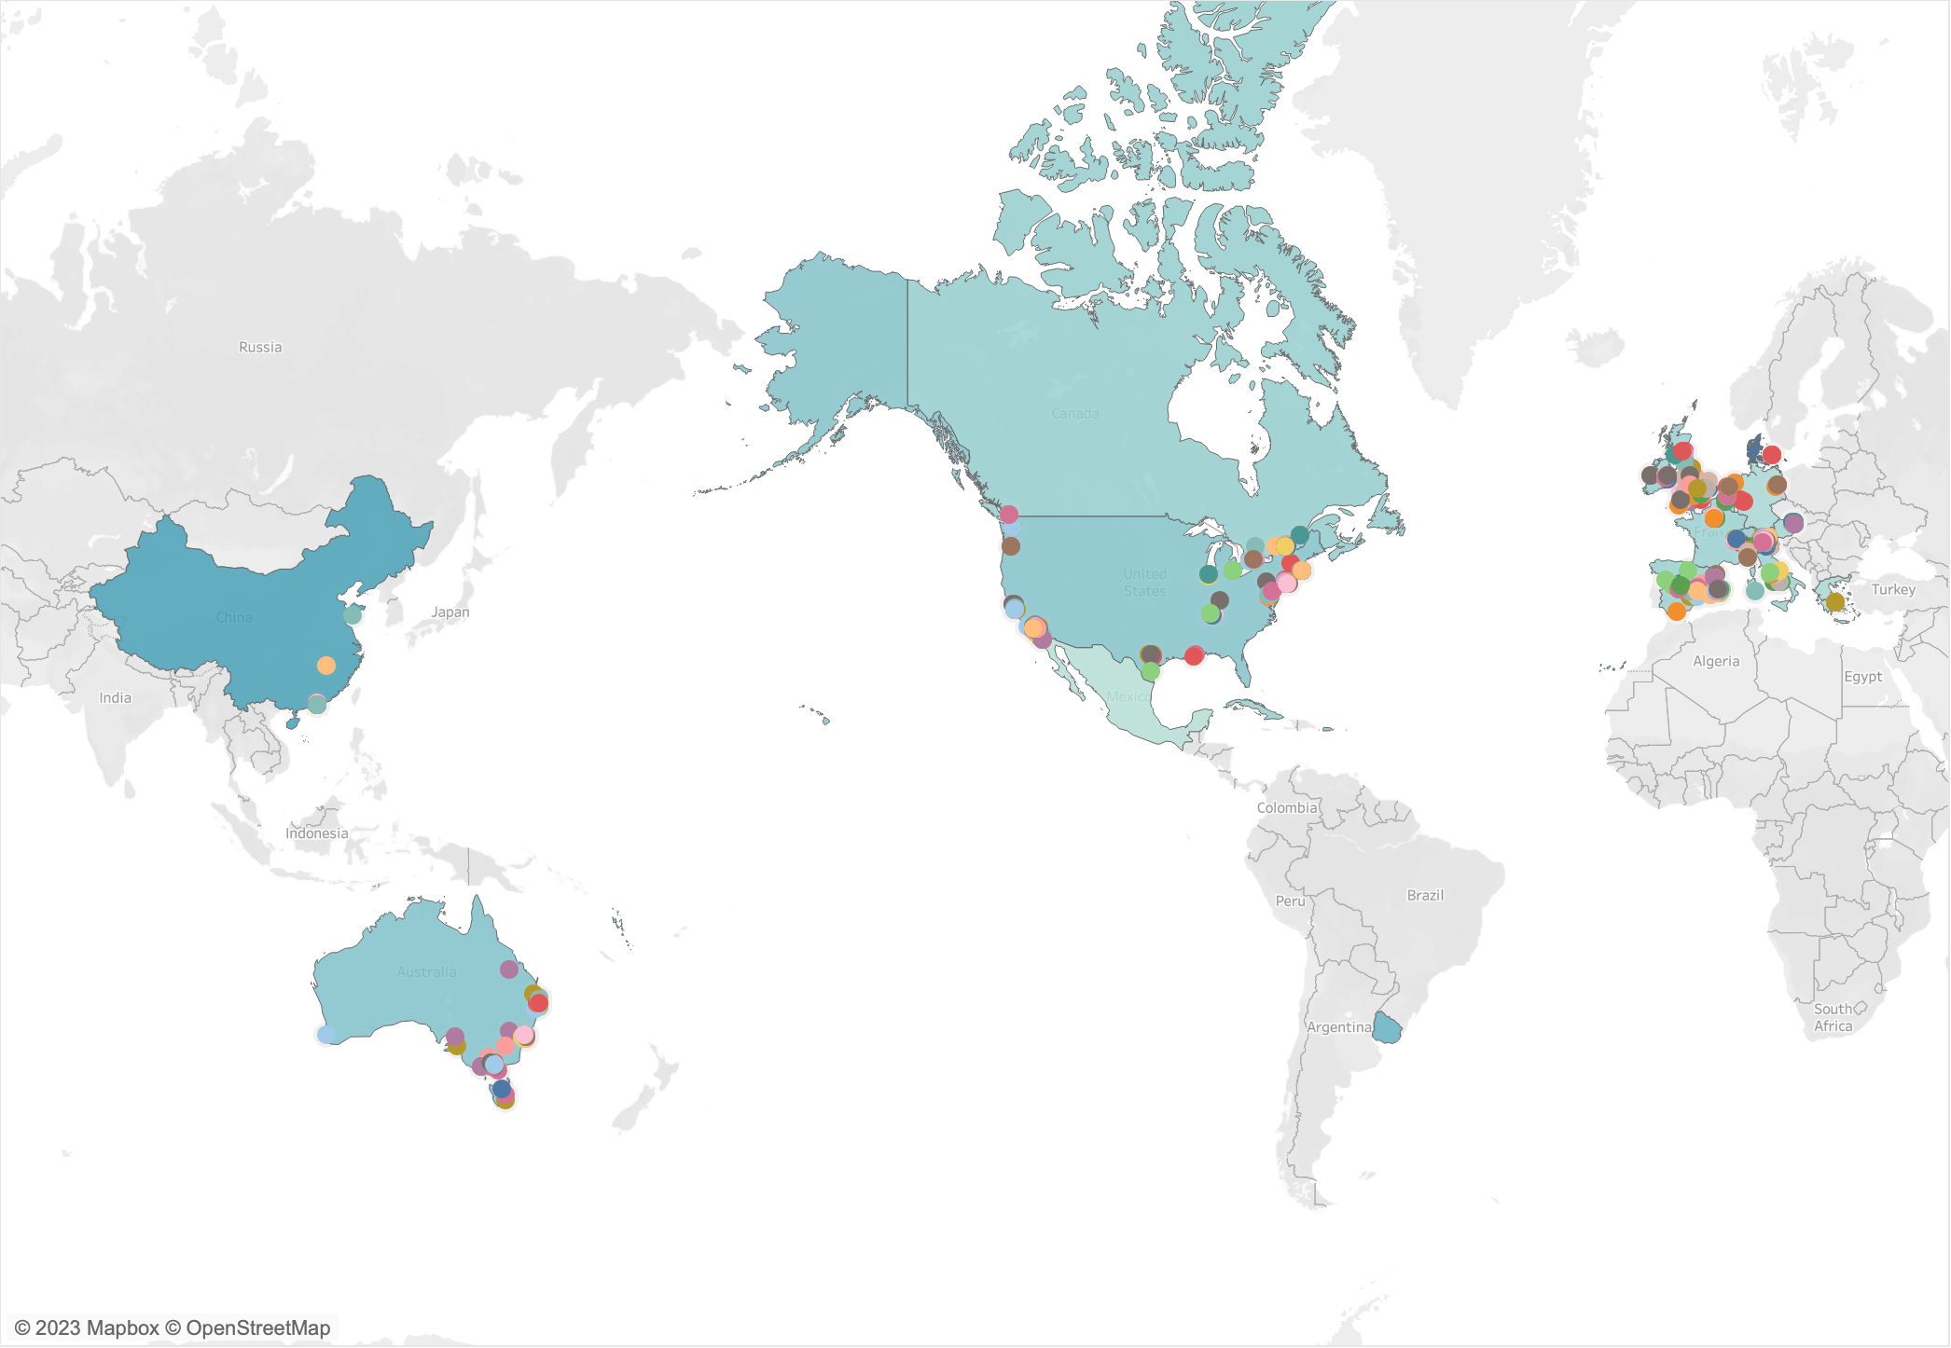
Our Data
Notes:
This map shows the areas where Airbnb is laid out. The colored dots represent cities where Airbnb is located, and these large blocks of color are country regions where aribnb is located. The shade of the color block indicates the average price. Lighter colors indicate lower prices.

Slide 5
Why This Data
Why is it big data?
Large amount of data
Complex structure
Cannot be captured, managed, and processed with a single database tool
Why choose this data set?
To understand market trends
To reveal patterns and correlations by price data
Inform decision-making and market strategies
this data can be applied to other domains
Notes:
Studying Airbnb’s pricing data is of significant value for several reasons. Firstly, it allows us to understand market trends. Fluctuations in price can provide insights into supply and demand dynamics at different locations and times. Secondly, price data can reveal patterns and correlations that might not be immediately apparent, such as the relationship between certain amenities or neighborhoods and price levels. Furthermore, for policymakers and city planners, understanding Airbnb’s pricing data is crucial. It can provide insights into how short-term rentals are affecting housing markets and neighborhoods, thereby informing policy decisions and urban planning strategies. Lastly, for researchers and data scientists, Airbnb’s pricing data is a rich resource for exploratory data analysis, predictive modeling, and machine learning. The lessons learned from this data can be applied to other domains and industries. Therefore, studying Airbnb’s pricing data is of great importance.

Slide 6
Problem Statement
Goal: Explore whether
1. the rating scores of Airbnb listings affect the prices of their corresponding listings
2. the features affect the prices of Airbnb
What we are doing: Predicting future Airbnb prices using machine learning methods and statistical modeling
Notes:
In this project, our goal is to explore how the rating scores and features of Airbnb listings affect their prices. We will achieve this goal through the following two main questions:
To answer these questions, we will predict future Airbnb prices using machine learning methods and statistical modeling. We will first collect and clean data, including information on listing ratings, features, and prices. Then, we will use this data to train our models and optimize them to improve the accuracy of our predictions.

Slide 7
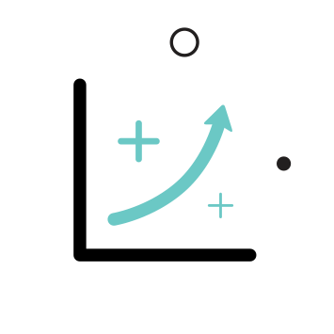
Part 2: Analysis

Slide 8
Our Method for Data Analysis
WORDCOUNT
Transit
Amenities
SQL
Response Time
Property Type
Notes:
Thanks for Jimeng's openning.
Please allow me to talk about our analysis methods.
There are two analysis in out research, data analysis and machine learning.
For data analysis, we summarized the data with wordcount and SQL.
In our data, transit and amenities are full of comments and words, so we use wordcount to find out what characteristics are more frequently appeared
For response time and property type, since they are more of nominal variables. We suggest that we use SQL's group by to show the difference between each group.

Slide 9
Our Method for Machine Learning
Linear Regression
Model 1: Price & Number of Different Rooms
Model 2: Price & Ratings on the website
Notes:
As for the machine learning part. We use linear regression to construct models.
The first model will show how the number of rooms of diff characteristics affect the price
And the second model will show how ratings affect the price

Slide 10
Part 2-1: Analysis Data Analysis

Slide 11
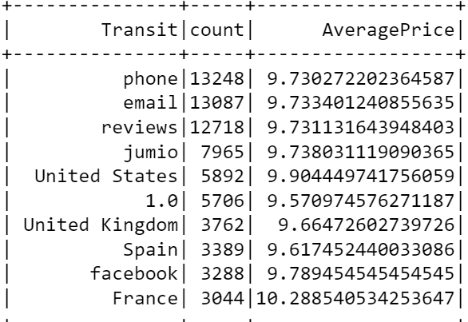
Data Analysis -- Transit
Ten most frequent words with their average price
Notes:
Let's see our result of transit.
We selected 10 most frequent words .
As our data visualization shows, there are three words that are extremely frequent.
Which are phone, reviews, email.
From our perspective, we suggest that customers take those three factors seriously.
For example, customers may decide which airbnb to live based on previous reviews
Customers may take the convenience of contacting with the airbnb owner through phones and email into account, etc.

Slide 12
Data Analysis -- Transit
Significantly frequent words: "phone", "reviews, and "email"
customers take those three factors seriously
e.g. previous reviews, contact availability
Notes:
Let's see our result of transit.
We selected 10 most frequent words .
As our data visualization shows, there are three words that are extremely frequent.
Which are phone, reviews, email.
From our perspective, we suggest that customers take those three factors seriously.
For example, customers may decide which airbnb to live based on previous reviews
Customers may take the convenience of contacting with the airbnb owner through phones and email into account, etc.

Slide 13
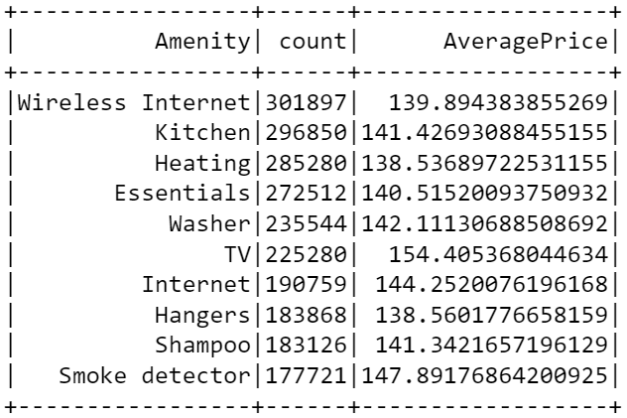
Data Analysis -- Amenities
Ten most frequent words with their average price
Notes:
As for amenities, we select 10 most frequent words as well

Slide 14
Data Analysis -- Amenities
TV leads to a higher price
Hosts should provide TV to attract customers
Low-budget customers should seek rooms without TVs
Notes:
As for amenities, we select 10 most frequent words as well

Slide 15
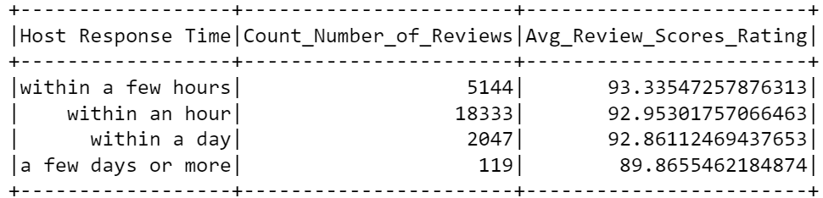
Data Analysis- Response Time
The relationship between the response time and the ratings

Slide 16
Data Analysis- Response Time
Fast, but not too fast.
Hosts should respond customers
within a few hours.

Slide 17
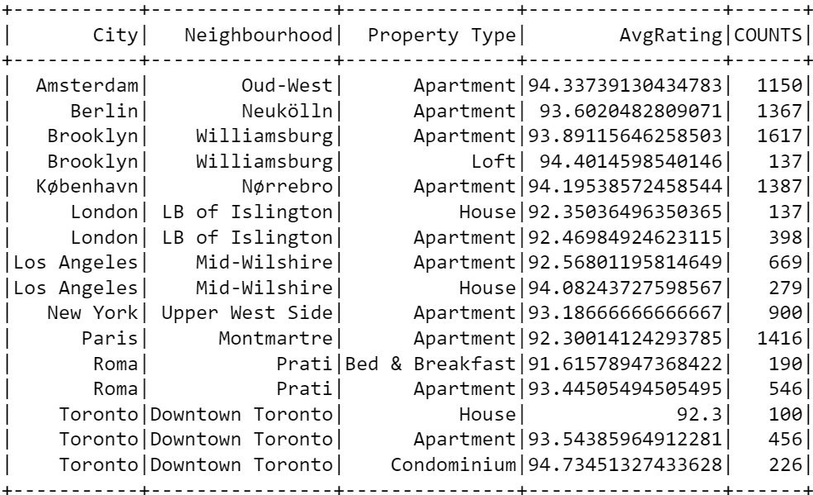
Data Analysis- Property Types
The most common property types in the top 10 city's top neighborhood.

Slide 18
Data Analysis- Property Types
Apartment is the majority type
Apartment owners in big cities can consider entering the Airbnb market

Slide 19
Part 2-2: Analysis Machine Learning

Slide 20
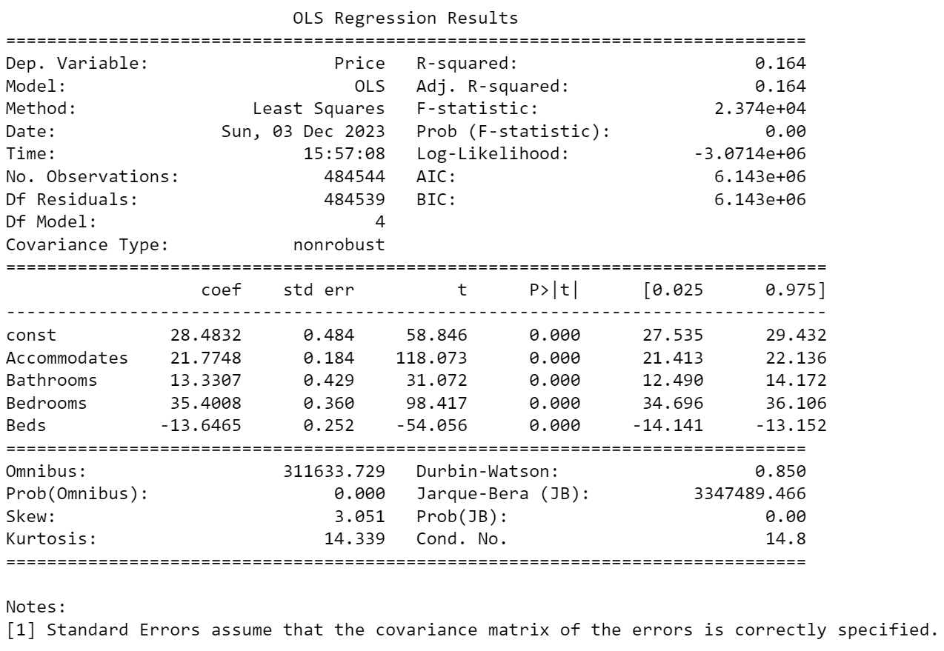
Machine Learning -- Price & Rooms 1
Independent Variables
Accommodates Acc
Bathrooms Bat
Bedrooms Ber
Beds Bed
Dependent Variable
Price Pri
Pri = 28.48 + 21.77 Acc + 13.33 Bat + 35.40 Ber - 13.65 Bed

Slide 21
Machine Learning -- Price & Rooms 2
Split the data:
70% training data
30% testing data
Mean Squared Error: 19624.42
Rsquared Error: 16.51%
Reasons:
Insufficient feature relevance
Underfitting
Lack of data
Notes:
Insufficient feature relevance: The independent variables might not be strong predictors of the price, implying that other unconsidered factors may have a more significant impact on the dependent variable.
Underfitting: The model may be too simple to capture the complexities of the data. This happens when the model does not have enough capacity to learn from the data.
Lack of data: Not having enough data can prevent the model from learning the underlying patterns effectively.

Slide 22
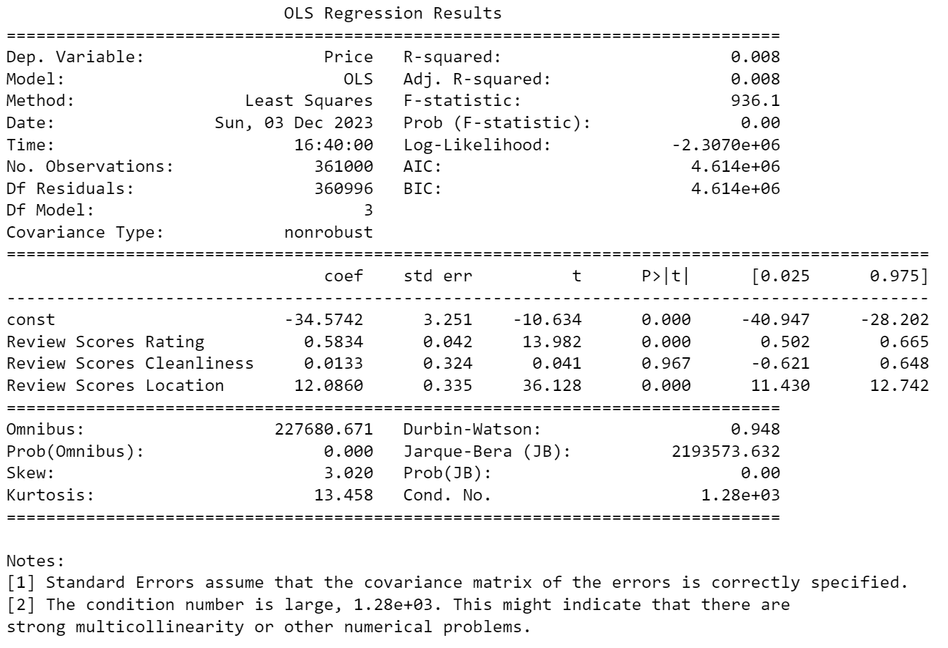
Machine Learning -- Price & Ratings 1
Independent Variables
Review Scores Rating RSR
Review Scores Cleanliness RSC
Review Scores Location RSL
Dependent Variable
Price Pri
Pri = -34.57 + 0.58 RSR + 0.01 RSC + 12.09 RSL

Slide 23
Machine Learning -- Price & Ratings 2
Split the data:
70% training data
30% testing data
Mean Squared Error: 75000.15
Rsquared Error: 34.73%
Reasons:
Insufficient or Irrelevant Features
Non-linear Relationships
High Variance in the Target Variable
Notes:
Insufficient or Irrelevant Features: The independent variables included might not provide enough information to predict the Price accurately. It's possible that important factors that significantly influence the Price are missing from the model.
Non-linear Relationships: If the relationship between the independent variables and the dependent variable is non-linear, a linear model will not capture these patterns effectively, leading to a low R².
High Variance in the Target Variable: If the Price has a wide range or a lot of variability that is not explained by the features, the model may struggle to make accurate predictions, leading to a high MSE.

Slide 24

Part 3: Conclusion

Slide 25
Conclusion
Attach importance to phone communication, email communication, and reviews
Providing TVs for customers to watch.
Hosts should respond to customers within a few hours
Apartment owners in big cities can consider entering the Airbnb market
Accommodates, Bathrooms, Bedrooms, Beds, Review Scores Rating, and Review Scores Location are all statistically significant predictors of Price
The linear regression models are not good machine learning method

